Slide 1



Fluter web renderers
Everything you need to know
immadisairaj

Slide 2

About me
$Who is immadisairaj > immadisairaj.dev
Software Developer @IBM
Flutter Developer
Open-Source Contributor
Packages in pub.dev
Musician
immadisairaj

Slide 3
Web renderer
Notes:
What is it? Ofc, it is something (under the hood) that renders our web page.
Before we go further, flutter uses dart2js to compile to the web.
Why are we even discussing this? Everything application needs rendering (flutter is not an exception). But, we are discussing this because, flutter uses two different type of renderers to render the web application.

Slide 4
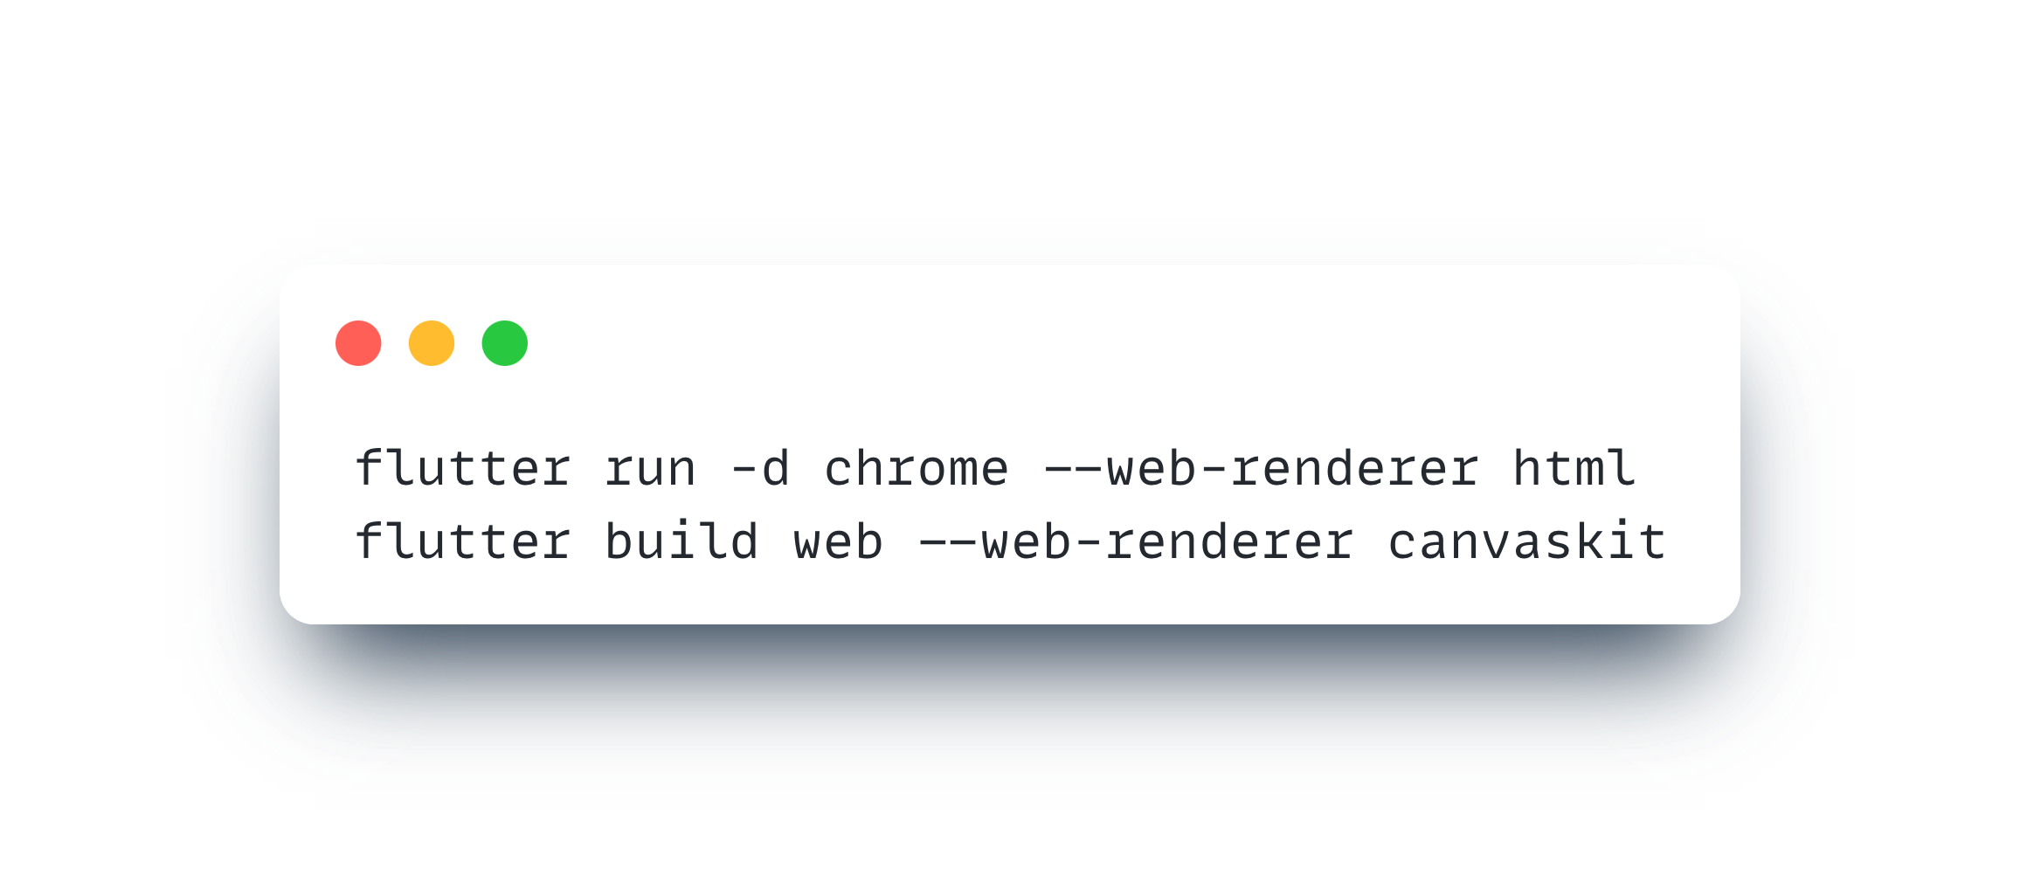
Web renderers
html
canvaskit
--web-renderer
Notes:
Two types: html and canvaskit. Why don’t I know this by default? Because it is not needed for most of the cases. Then why are you telling me this? Well, because “To learn is to Grow”. You can better understand and build web applications in flutter.
--web-renderer (auto) - HTML on mobile, canvaskit on desktop.
Use the —web-renderer argument to specify either html or canvaskit.

Slide 5
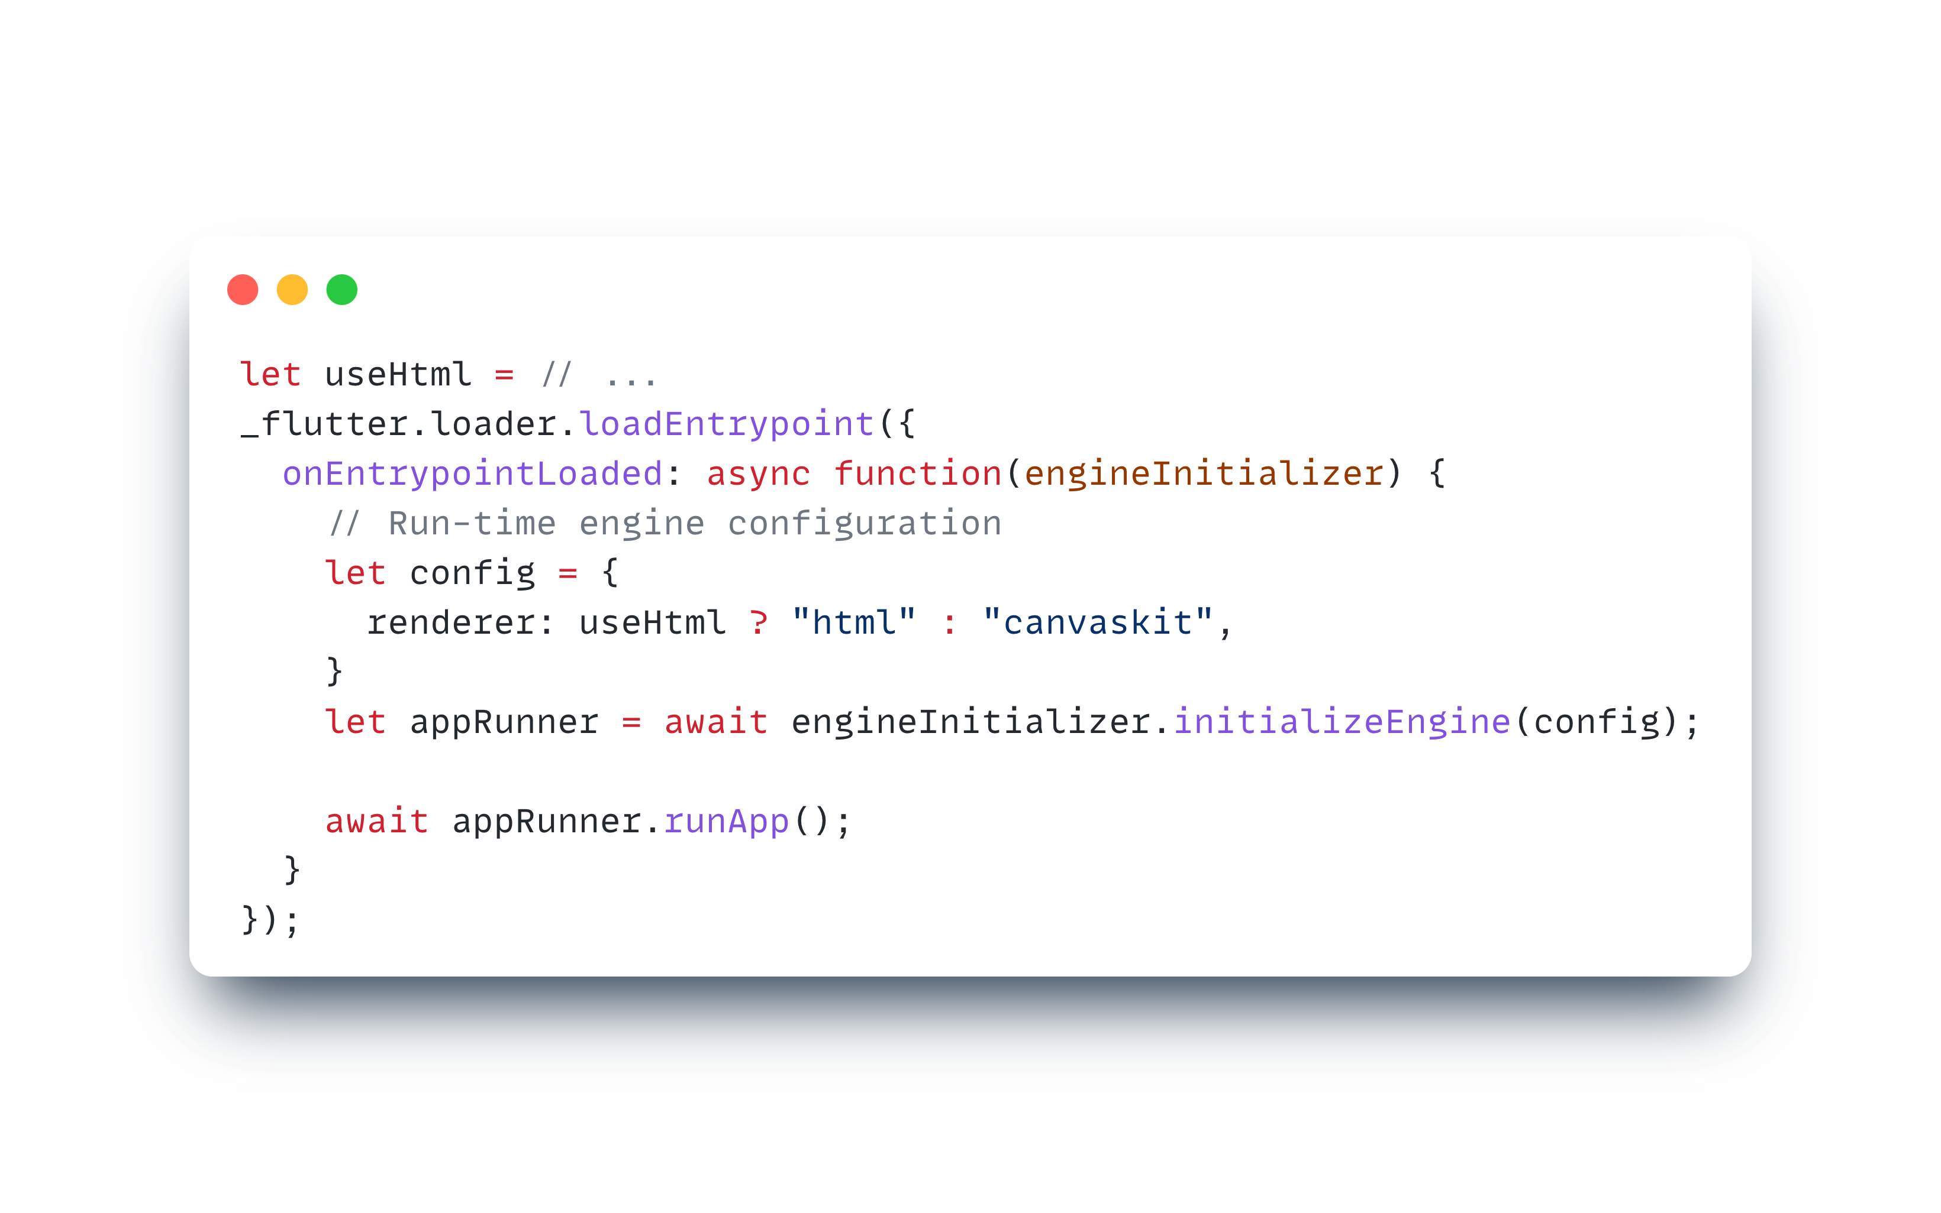
Runtime Configuration
Source : Flutter Docs
Notes:
Render in auto for this to work.
If you want to customise it, you can use the flutter web init.

Slide 6
Web renderers
html
canvaskit
--web-renderer
Notes:
Now that we looked at what html is, let’s see what canvaskit renderer is about.

Slide 7
--web-renderer html
HTML Elements, CSS, Canvas Elements & SVG Elements
Small bundle size
Faster initialisation
Uses native text rendering
Problematic SVG support
Few Limitations
Notes:
Html web renderer is mostly made of the HTML elements, css (styles), canvas elements, svg elements. The details about these, we will look at them soon.

Slide 8
Web renderers
html
canvaskit
--web-renderer
Notes:
Now that we looked at what html is, let’s see what canvaskit renderer is about.

Slide 9
--web-renderer canvaskit
WebGL and CanvasKit (Skia + WebAssembly)
+2MB of bundle size (and more?)
Faster performance
Higher widget density
Browser Independent
CORS issues
Notes:
Behaves almost same as the mobile and desktop apps. Slow Initialisation.
Let’s discuss the “and more” in sometime.

Slide 10
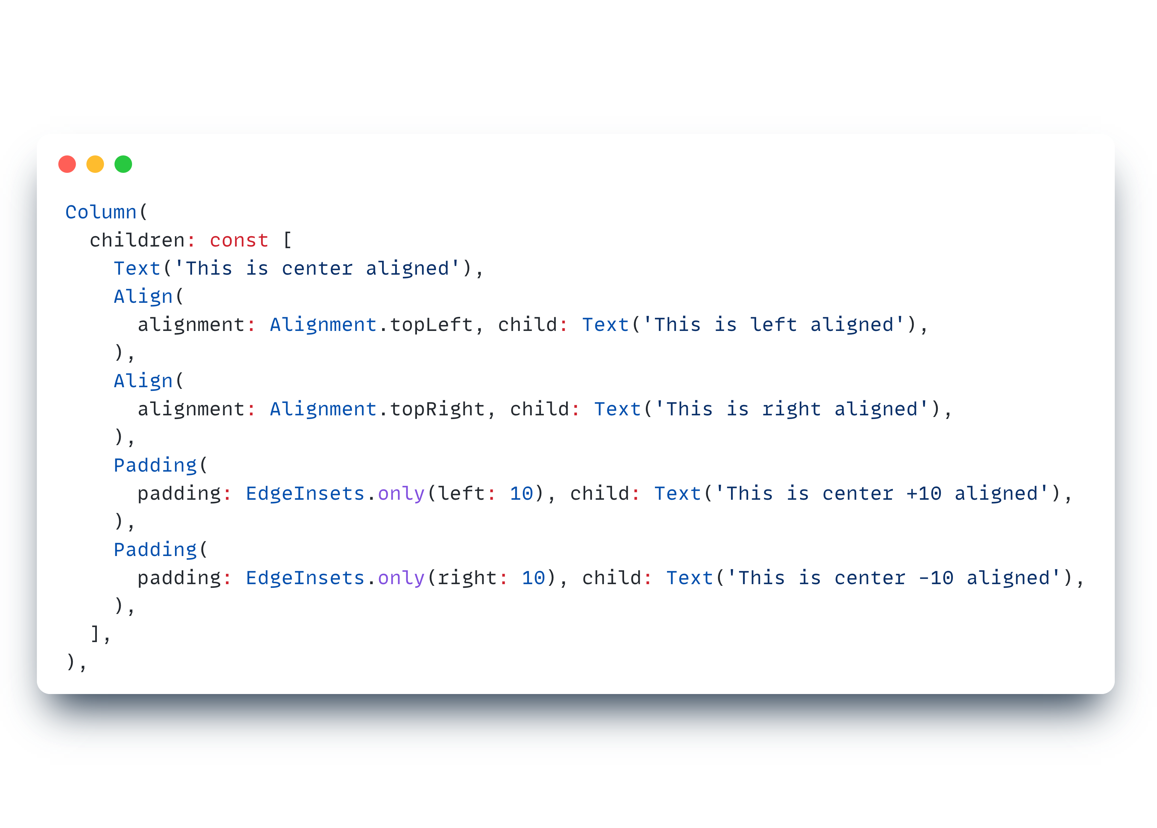
Simple Text render example
Notes:
Texts just aligning differently.

Slide 11
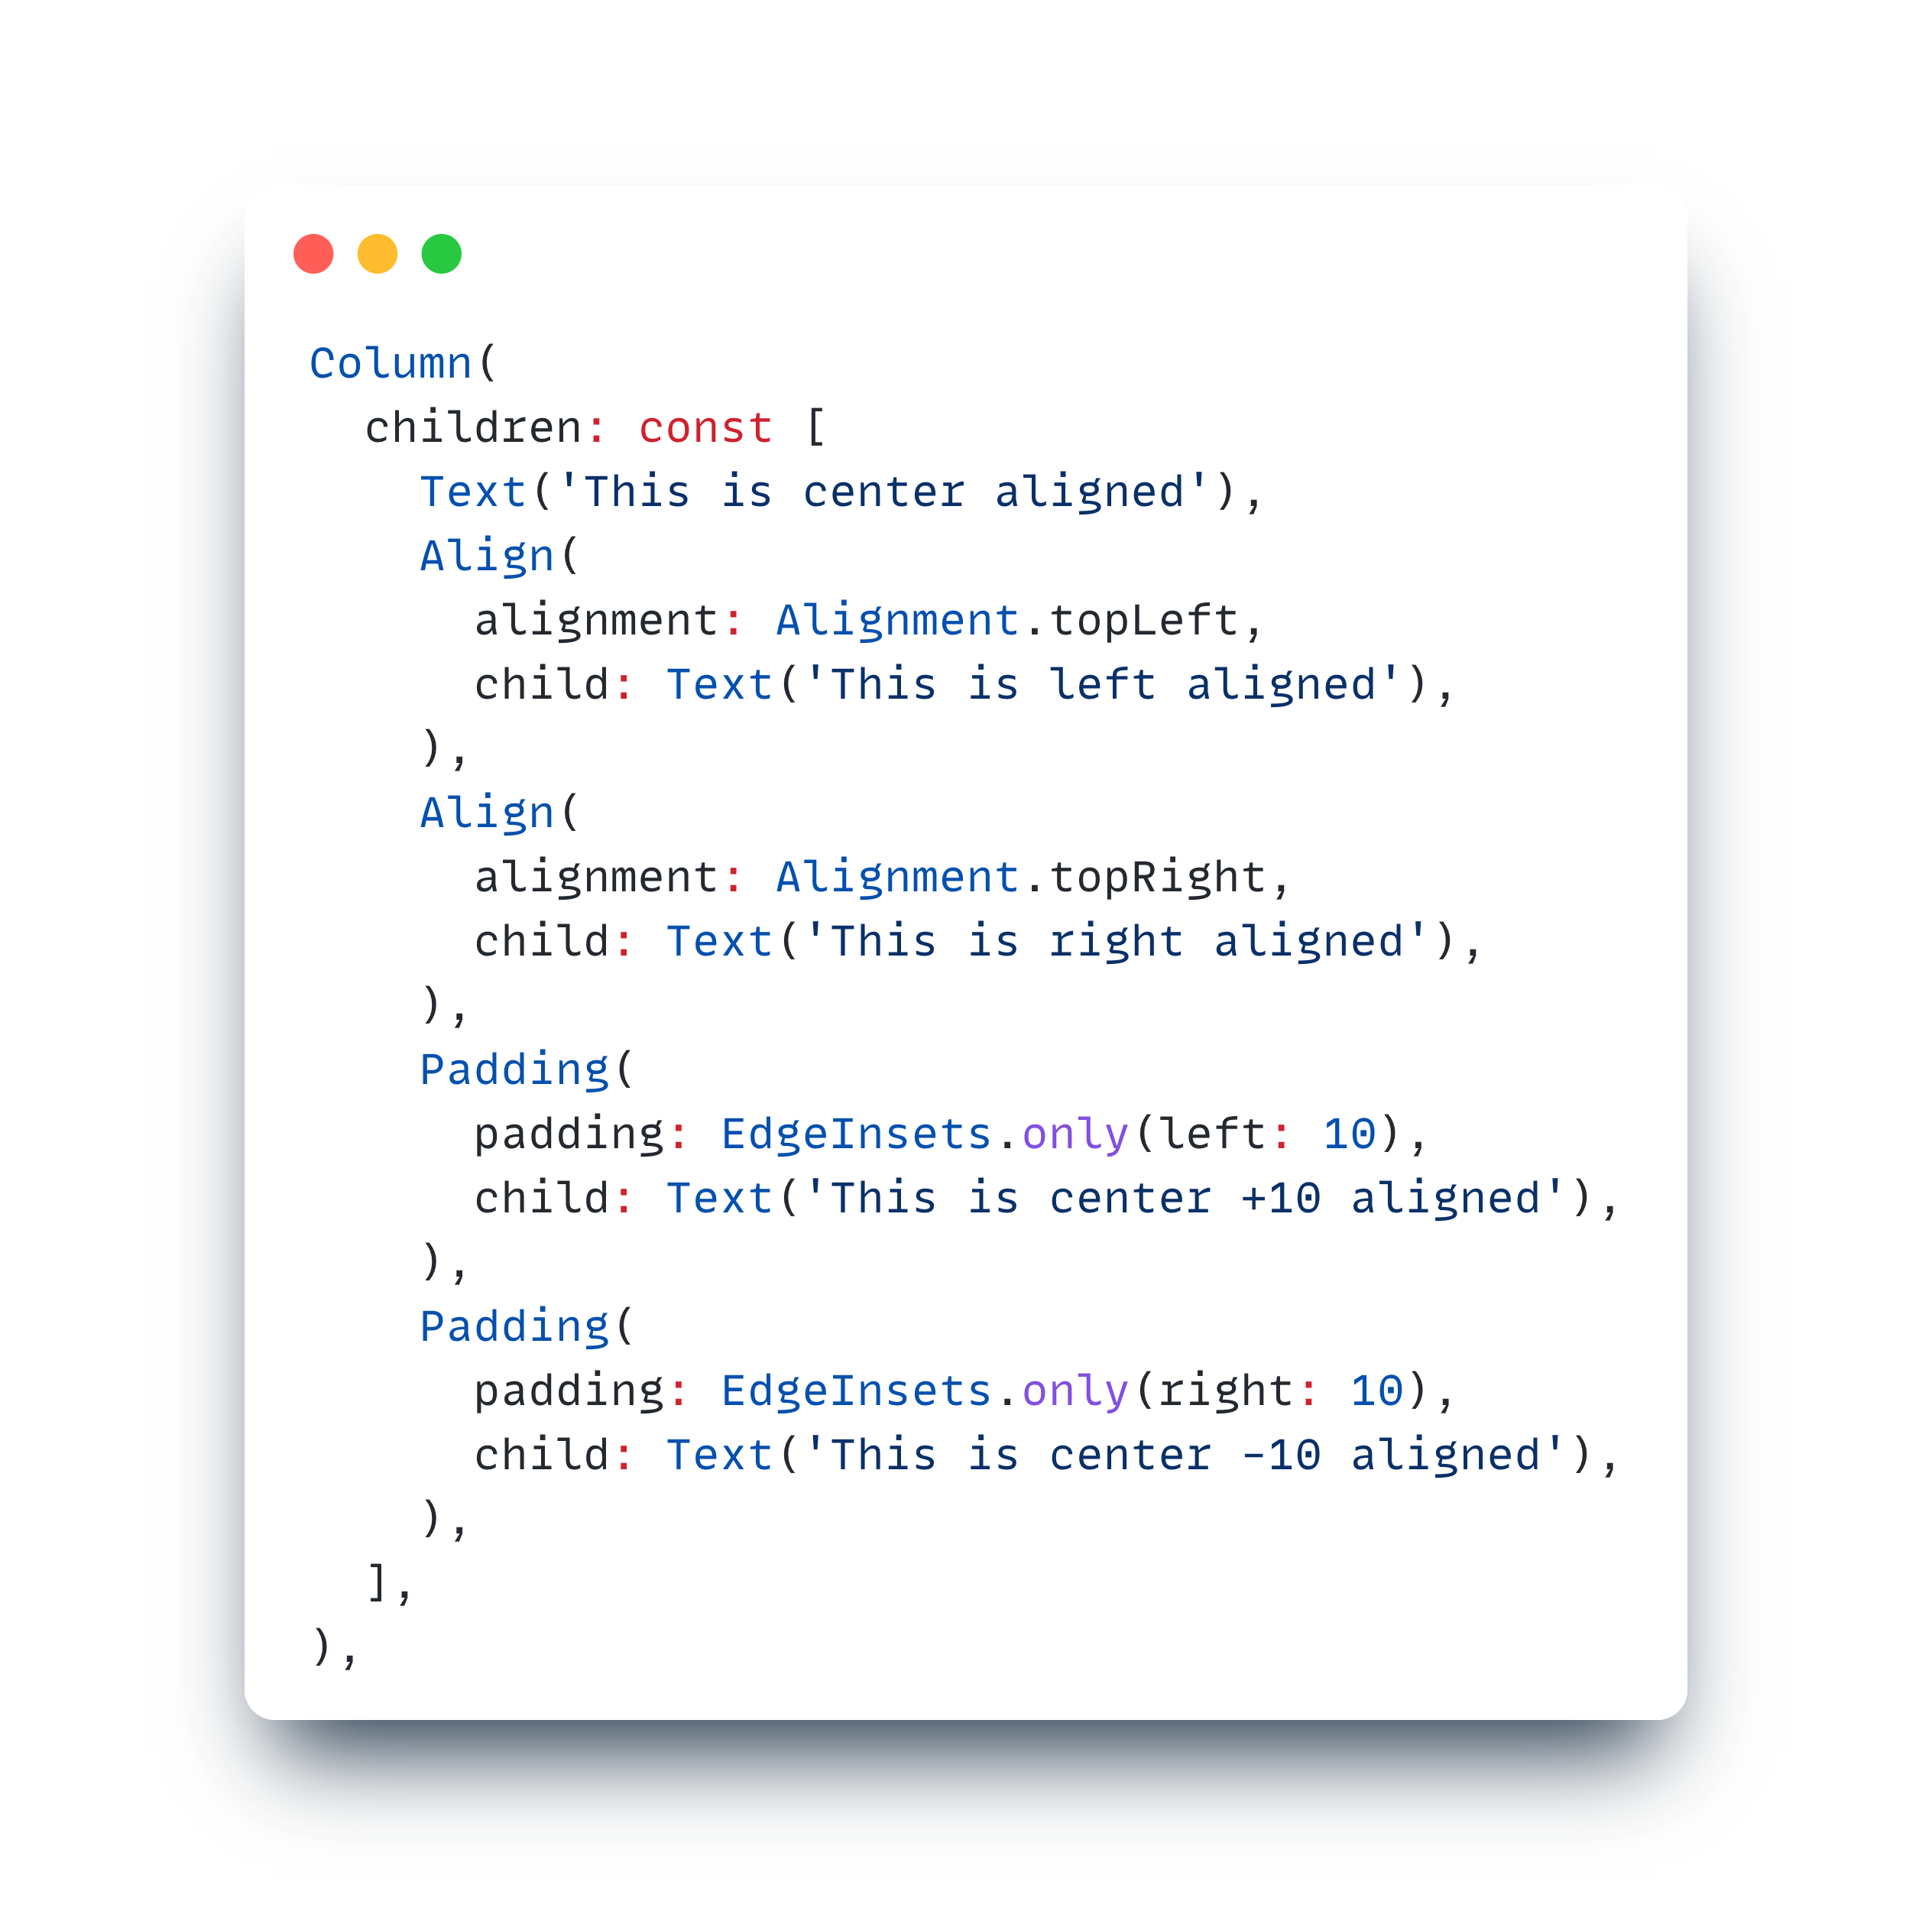
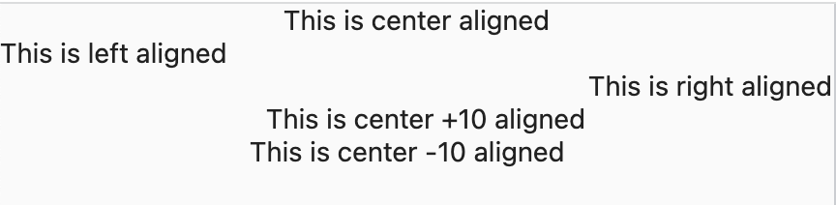
Simple Text render example
Notes:
Output

Slide 12
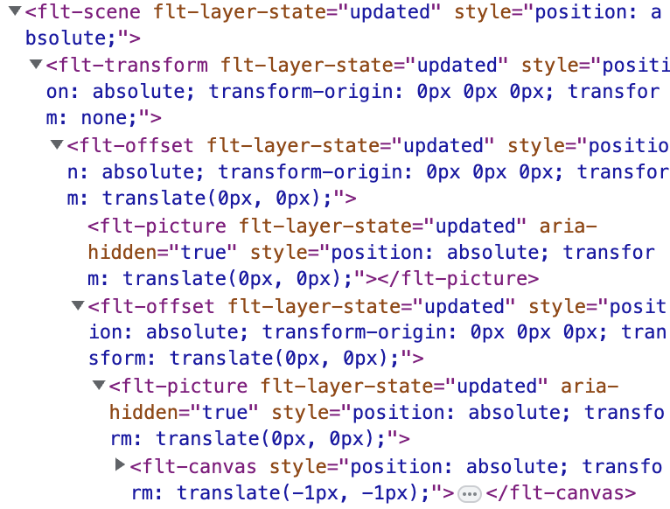
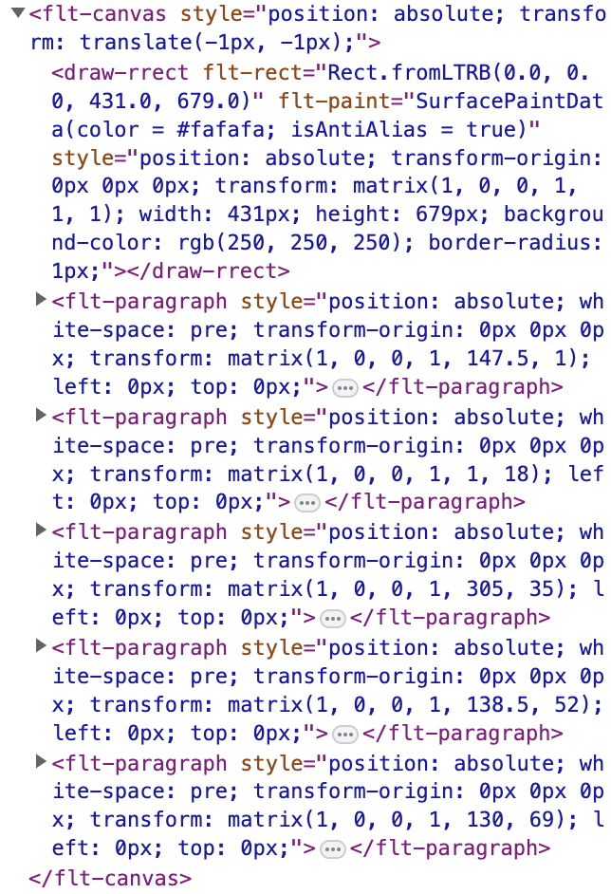
Simple Text render example
html
Notes:
What it looks like when rendering in html. Checking in the inspector, we can see the html elements.

Slide 13
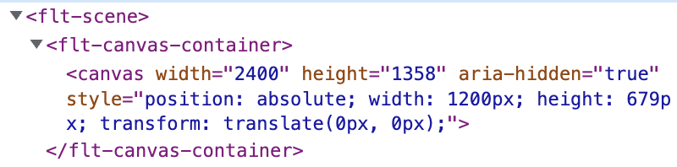
Simple Text render example
canvaskit
Notes:
What it looks like with canvaskit render. Here, we can just see the canvas element where everything (all the painting) is done behind the scenes.

Slide 14
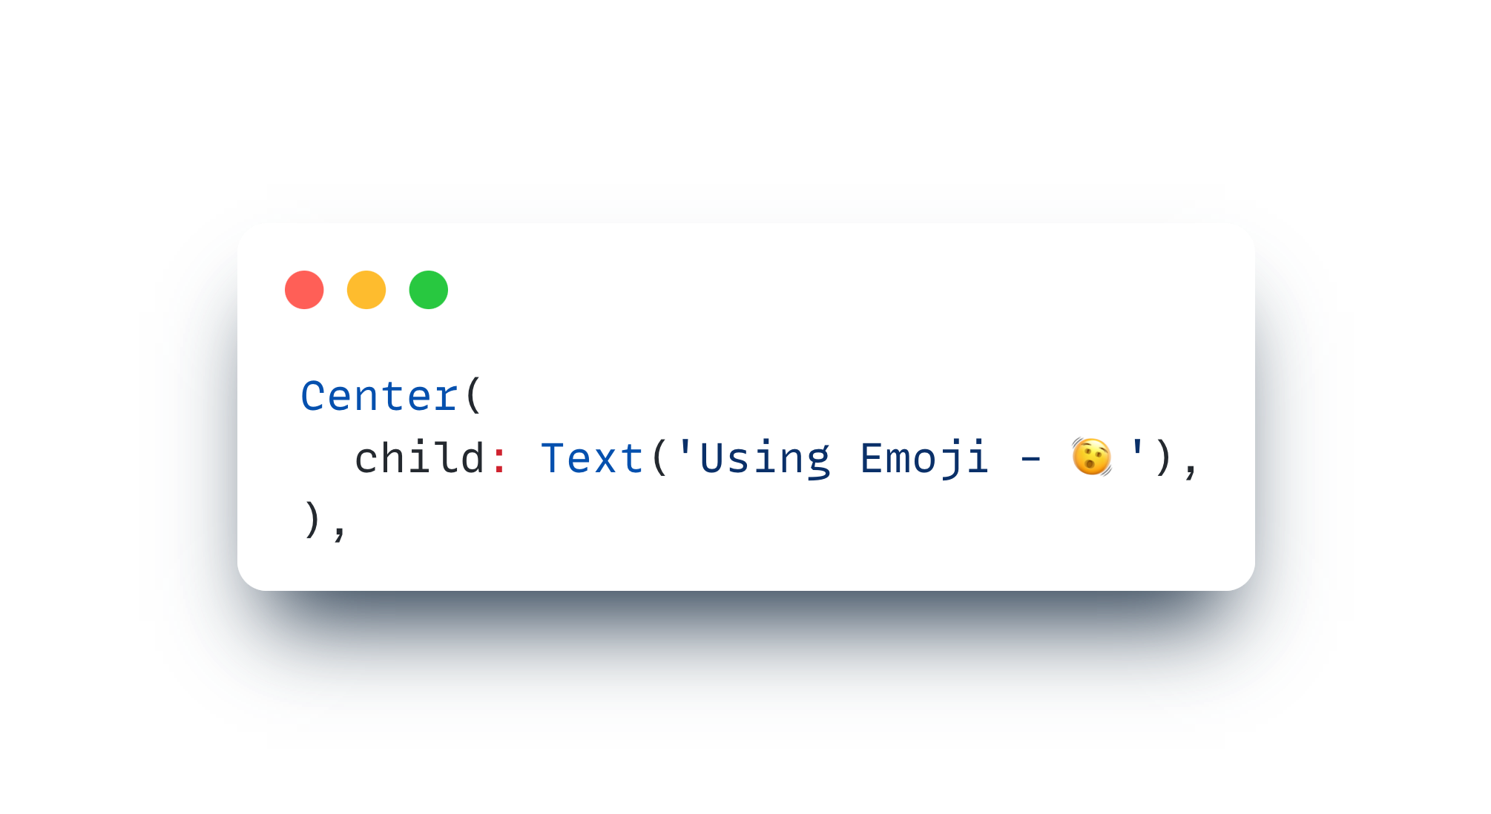
Native Text Rendering
Notes:
We’ve seen the native text rendering as an advantage in html render. Now, let’s look at what that exactly mean. This is a code example that uses an emoji. Some emoji that shakes my head.

Slide 15
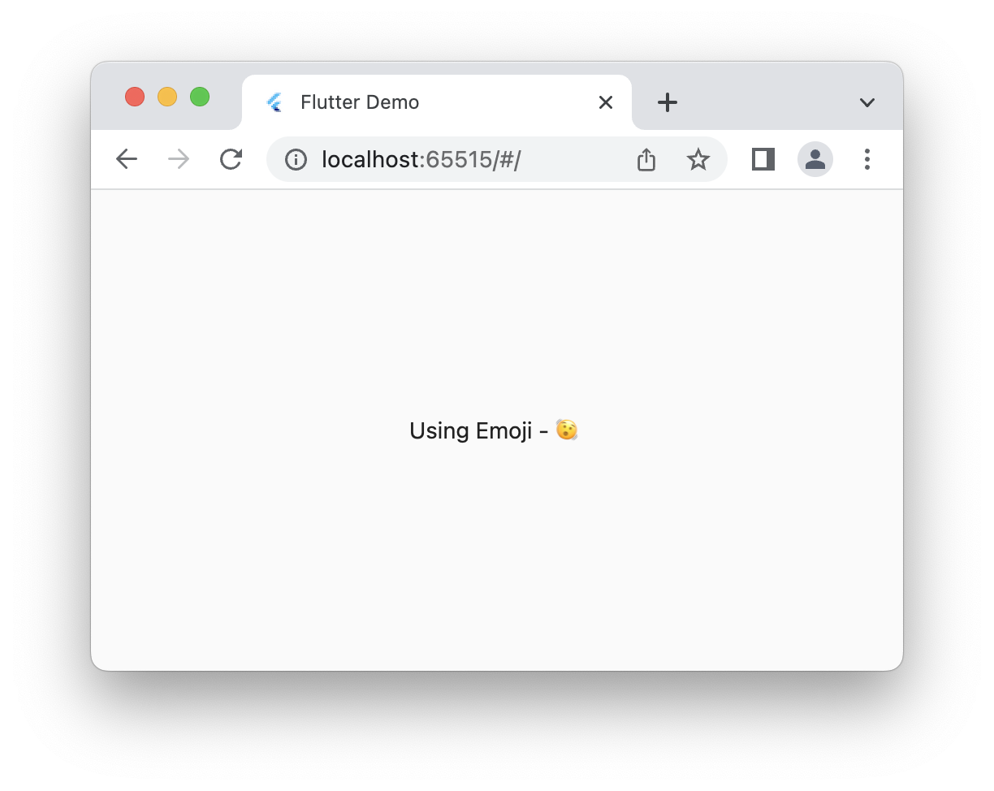
Native Text Rendering
html
Notes:
There’s no doubt that in that. It is expected.

Slide 16
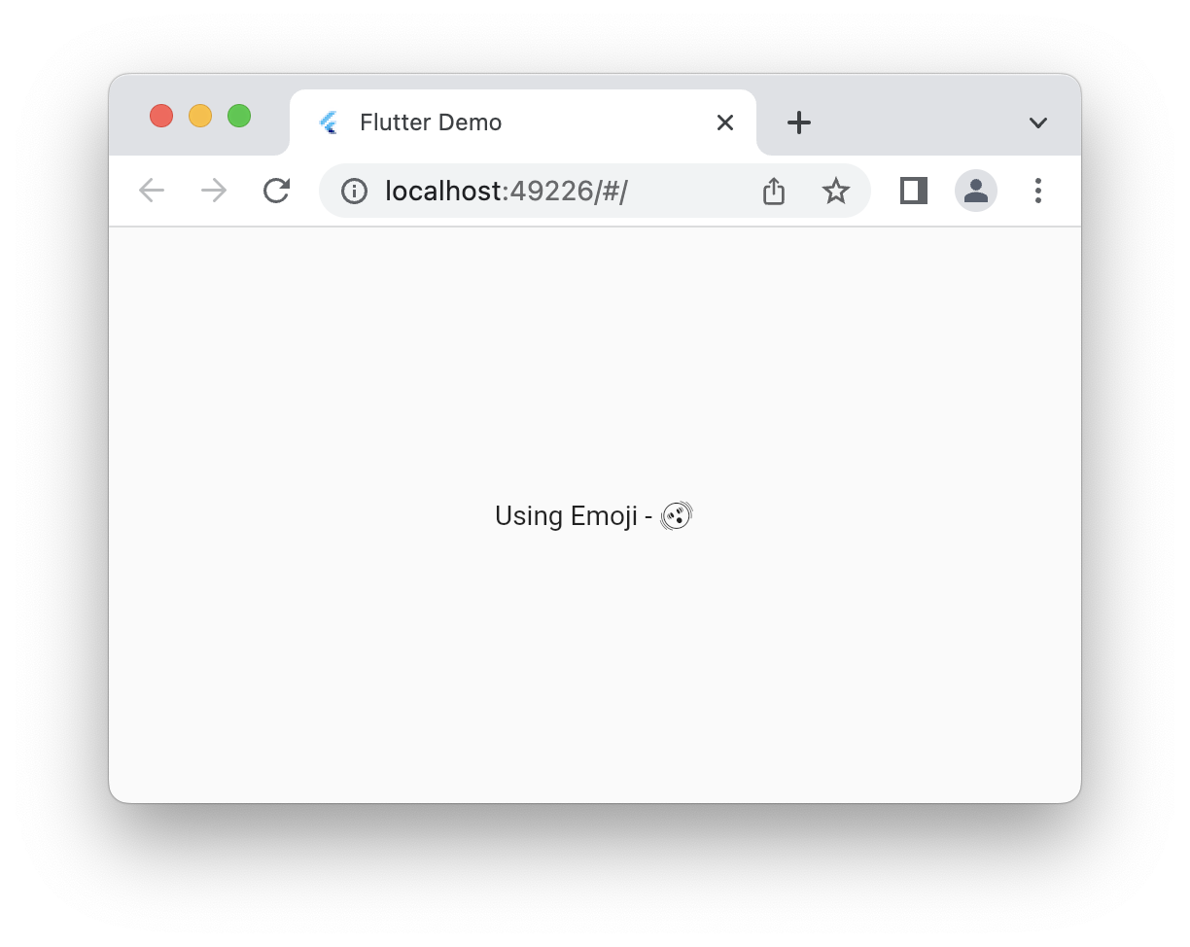
Native Text Rendering
canvaskit
Notes:
Now, what about canvas kit. It looks like I went really back to the olden days and took my picture in black and white. But why? That’s exactly the point where native text rendering comes in.

Slide 17

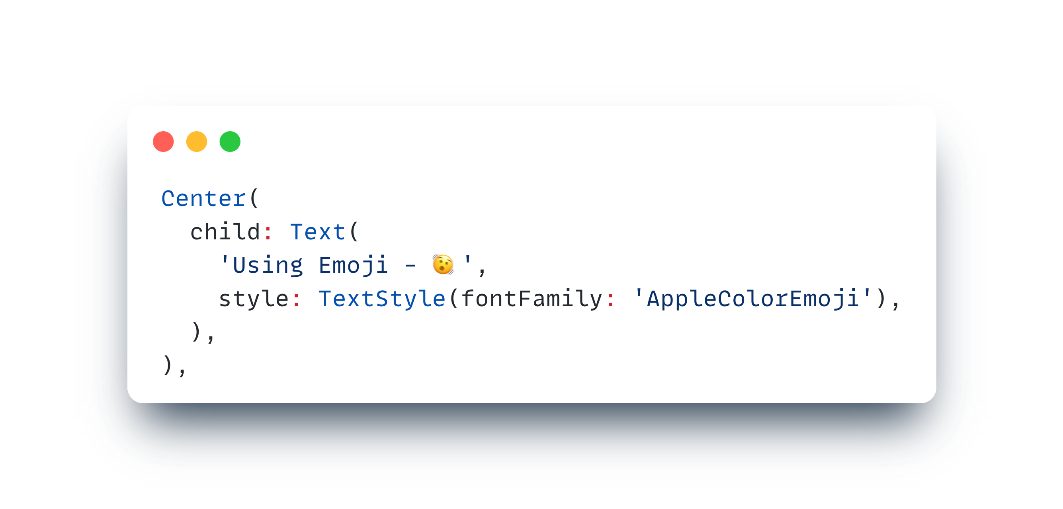
Native Text Rendering
canvaskit + font
Notes:
This is exactly my point, for just one emoji - we need to ship the whole font style.
The text to render properly, have to use RichText and TextSpans (more effort and more to ship).

Slide 18
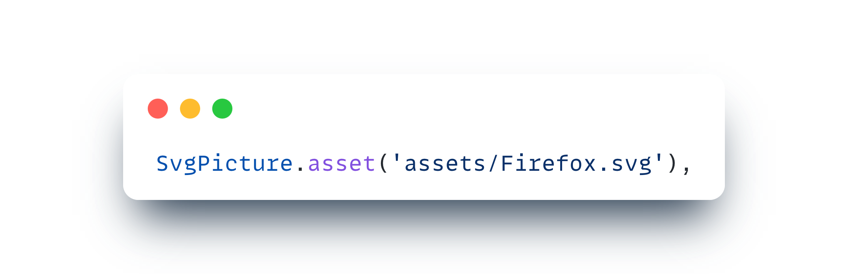


Problematic SVG Support
Svg Source : flutter_svg issues
html
canvaskit
Notes:
Canonical two point gradient problem in html.

Slide 19
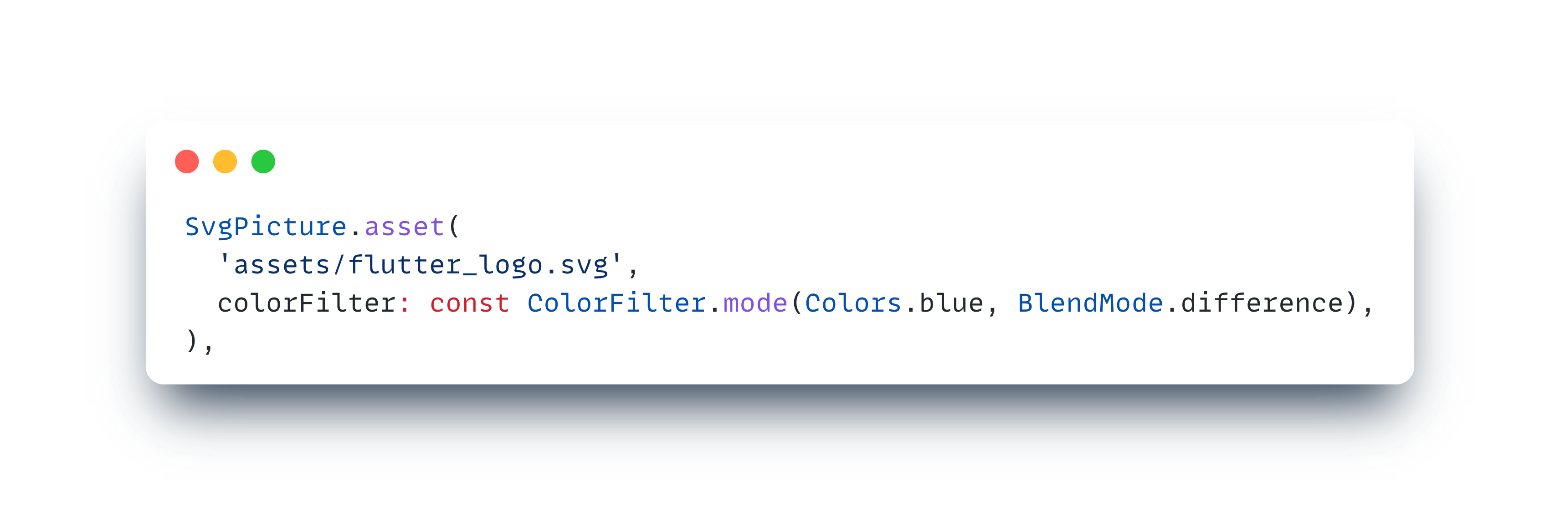


Limitations in html
html
canvaskit
Notes:
In html, canvas.saveLayer and a few more methods won’t work. Also, some limitations for Image widget would be Image.toByteData. Network image - cacheHeight, cacheWidth are ignored.

Slide 20
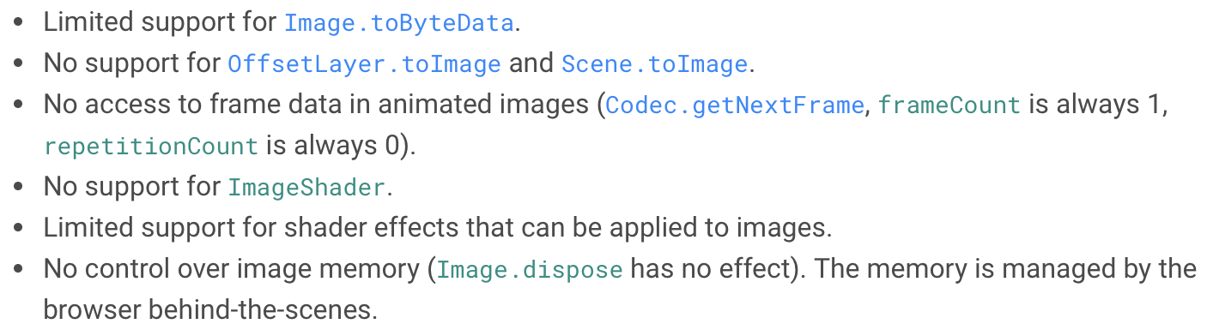
Limitations in html
Source : Flutter Docs
Notes:
These are some limitations in html listed in the Flutter Docs.
Now that we came to images, let’s look at some things about images in flutter web.

Slide 21
IMAGES ON WEB
Different methods for displaying image
<img>, <picture> - HTML elements
Browser caching, image optimization and memory management
drawImage on <canvas> - Canvas element
Image sizing, read pixels for further processing
Custom codec that renders to WebGL canvas
Apply custom algorithm to pixels, use GLSL (shaders)
Notes:
First two - html renderer
Last - canvaskit renderer

Slide 22
CORS
Cross-Origin Resource Sharing
html
canvaskit
Arbitrary sources
COrs Policy
Notes:
HTML - arbitrary sources (with limitations) (html elements)
CanvasKit - should follow CORS policy

Slide 23
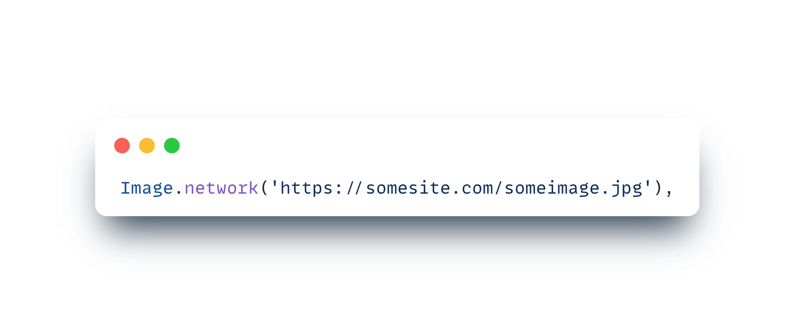
CORS
Cross-Origin Resource Sharing
html
canvaskit
Arbitrary sources
COrs Policy
Notes:
Image from some source

Slide 24

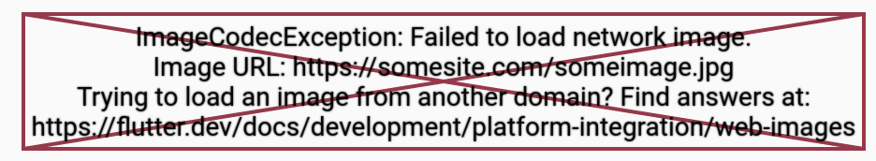
CORS
Cross-Origin Resource Sharing
html
canvaskit
Notes:
HTML - will use <img> html element.
Why? because canvaskit has to access pixels which needs to follow CORS policy.

Slide 25
Solution - CORS
How to solve CORS issue in CanvasKit renderer
Image as asset
Becomes same origin
Host Image in CORS-enabled CDN
Content delivery network - configure custom domains
Use CORS Proxy
If don’t have any control on image server

Slide 26
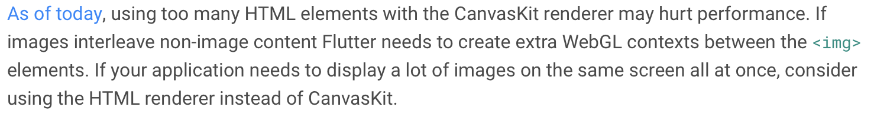
From flutter docs
Source : Flutter Docs
TL;DR? Use html renderer when too many images

Slide 27
What to choose?
Faster Loading
Lots of Images
Lots of Fonts or Emojis
Less Size
html
Performance
Pixel perfect rendering
No size constraint
Proper images/svg support + their manipulation
canvaskit

Slide 28
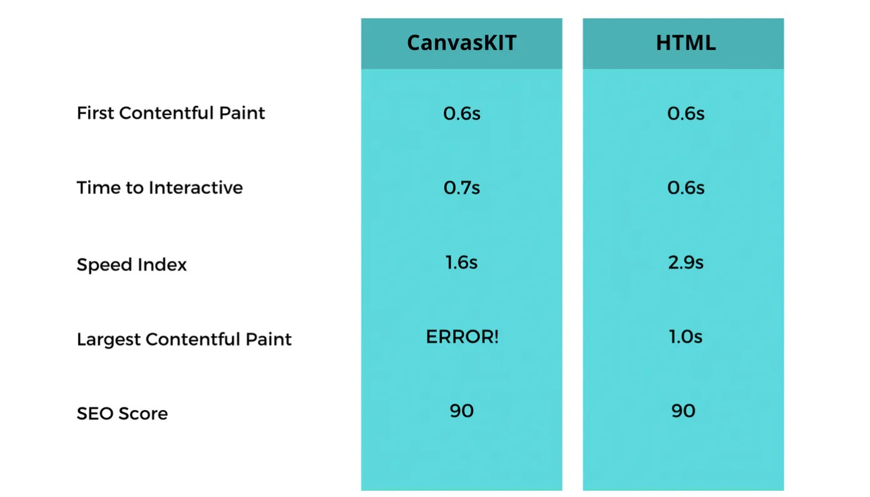
Additional Content
Source : GeekyAnts Blog
Notes:
Some chrome based performance tests. First Contentful Paint - first feedback.
Largest Contentful Paint - Time taken to show the largest content.

Slide 29
Future of flutter web
Web assembly (Wasm)?

Slide 30
Thank you
Happy Fluttering!
https://immadisairaj.dev/talks

